Slide 1
PRESENTATION STRATEGIES
Presented by :-
Vidya Niwas Pandey
1

Slide 2
OBSERVATION
PRESENTATION STRATEGIES
Communicate complex information in simple and interesting ways to keep the audience engaged
Communicate thoughts and feelings effectively
Develop self-confidence
Gain real-world skills, such as the ability to present accomplishments and skills during a job interview

Slide 3
Objective:
To provide participants with the practical skills and knowledge necessary to express themselves clearly, with confidence and power, in a variety of speaking situations.
2. Students will be taught presentation techniques:
How to plan and structure an effective presentation.
How to develop ideas.
Effective delivery methods.
How to overcome anxiety, fear and nervousness when making a presentation.
3

Slide 4
1. DEFINING PURPOSE
The following are the main points that will help you to make effective presentation :-
Defining purpose
4

Slide 5
1. DEFINING PURPOSE
Generally presentation is arranged for an explanation of particular issue.
5

Slide 6
1. DEFINING PURPOSE
Presentation may be for collaboration, for problem solving, for making a major decision.
6

Slide 7
1. DEFINING PURPOSE
In short, presentation includes , information, analyzation, explanation and persuasion.
7

Slide 8
The following are the main points that will help you to make effective presentation :-
2. Analysis audience and locate
8

Slide 9
Before presentation it is very necessary to understand the audience and the place where you are going to present your views.
9

Slide 10
One should understand the audience properly in order to prepare the message effectively.
10

Slide 11
Understanding audience includes: to know their level, knowledge, background, culture, expectations etc.
11

Slide 12
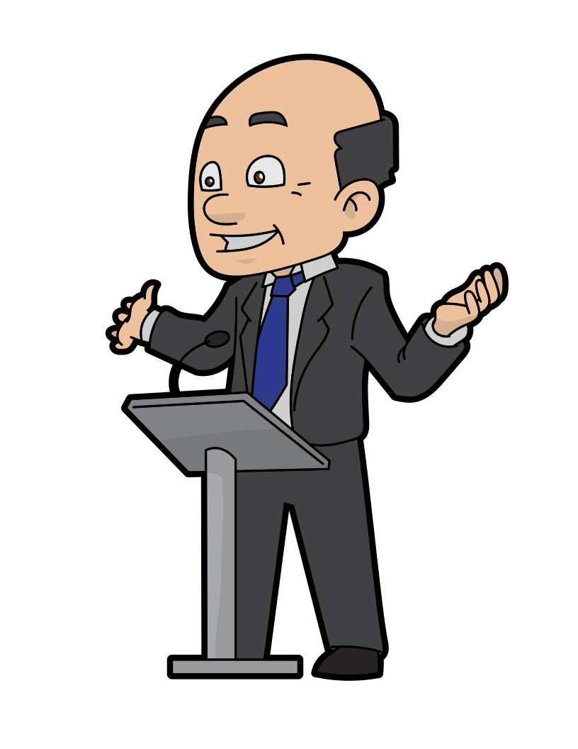
An effective speaker makes ample efforts to understand audience.
12

Slide 13
The following are the main points that will help you to make effective presentation :-
3. Organizing contents
13

Slide 14
It becomes very important for the speaker to organize the content logically.
14

Slide 15
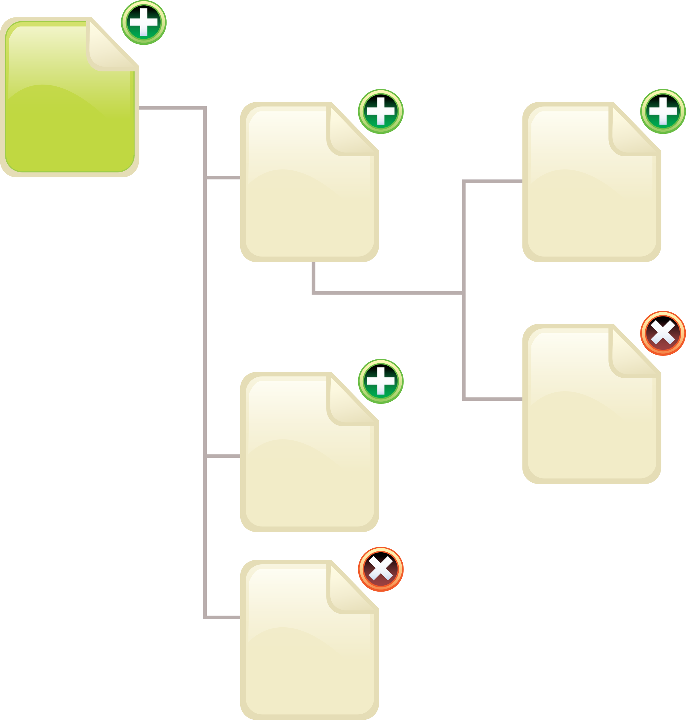
The speaker comes with different kinds of information regarding the topic of presentation.
15

Slide 16
The content can be arranged/organized in three categories:
Introduction,
Body
Conclusion
16

Slide 17
Introduction
This section of the presentation talks about the relevance of the topic,
Definition of the topic or starts with any suitable quote,
Anecdote or brief story of the topic which leads the audience to understand the importance of the topic.
17

Slide 18
Body
The body of the presentation contains the main or central idea.
The following are different way to organize the body of the presentation:
18

Slide 19
a) Chronological
19

Slide 20
b) Categorical
20

Slide 21
c) Cause and effect
21

Slide 22
d) Problem-solution
22

Slide 23
e) Contrast and comparison
23

Slide 24
Conclusion
This section contains brief summary of the points which are discussed in the body.
Appropriate words should be used to conclude the topic.
24

Slide 25
The following are the main points that will help you to make effective presentation :-
4. Preparing an outline of the presentation
25

Slide 26
Preparing an outline is a mechanical framework in which the contents of presentation arranged in order to deliver.
26

Slide 27
An outline serves as a guide to show the speaker the right path for the presentation. .
27

Slide 28
Knowing the outlined sequence like Introducing, body and content well in advance gives the speak the confidence to control his or her speech anxiety.
28

Slide 29
The following are the main points that will help you to make effective presentation :-
Use of visual aids
29

Slide 30
The following are the main points that will help you to make effective presentation :-
6. Nuances of delivery

Slide 31
In oral presentation the style or the shade of delivery is very important Basically there are three modes of delivery.

Slide 32
Extemporaneous:
It is very popular as it is a spontaneous over flow of the subject.
It does not require detailed preparation but to look the main points and start in form of the audience. It requires best oratory skills.

Slide 33
Manuscript:
Another mode of deliver is manuscript .
It means the speech is written in a paper and speaker has to read only.
It is the most easy mode of presentation since the speaker is not required to recollect any matter and no need to memorize it.
Simply louder reading of text would serve the purpose.

Slide 34
Impromptu:
It is an informal style of presentation.
It is used for informal speech or at familiar group.
It is generally used at non business gathering.
It is very natural in tone so gives no stress to speaker and listener understand it easily.

Slide 35
The following are the main points that will help you to make effective presentation :-
Defining purpose
Analysis audience and locate
Organizing contents
Preparing an outline of
the presentation
Use of visual aids
Nuances of delivery
Non-Verbal elements
Defining purpose
Analysis audience and locate
Organizing contents
Preparing an outline of
the presentation
Use of visual aids
Nuances of delivery
Non-Verbal elements
7. Non-Verbal elements

Slide 36
NON-VERBAL ELEMENTS
Our appearance, facial expression, eye contact, posture, gesture, and space we share with our audience, all shows our interest, enthusiasm, dynamism, intension, and confidence to our audience

Slide 37
Tips to use body language effectively during your presentation:-
Wear a formal dress and use simple accessories
Use facial expressions to exhibit your enthusiasm and interest
Do not show irritation or anger even when someone interrupts you.
Make eye contact with all the sections of the audience to observe their reactions.
Use well timed gestures; avoid monotonous gestures.
Do not come very close to the audience always maintain a distance.
While using the blackboard raise your voice and look at the audience in between.
Try to concentrate on your ideas and your audience.
37

Slide 38
ADVANTAGE PRESENTATION STRATEGIES
Presentation offer you the opportunity to:
Interact with audience
Observe there reactions
Gauge the level of there understanding
Emphasize key point
Assess the level of acceptance
of your message

Slide 39
DISADVANTAGE PRESENTATION STRATEGIES
The message is only heard once at the place of delivery set by the speaker.
Some people unable to attend.
The effectiveness relies very much on the ability of the speaker.

Slide 40
Overview :
Defining purpose.
Analysis audience and locate.
Organizing contents.
Preparing an outline of the presentation.
Use of visual aids.
Nuances of delivery.
Non-Verbal elements.

Slide 41
THANK YOU
All of you

